Slide 1
Heart Disease Book1
File created on: 12/5/2024 1:46:32 AM

Slide 2
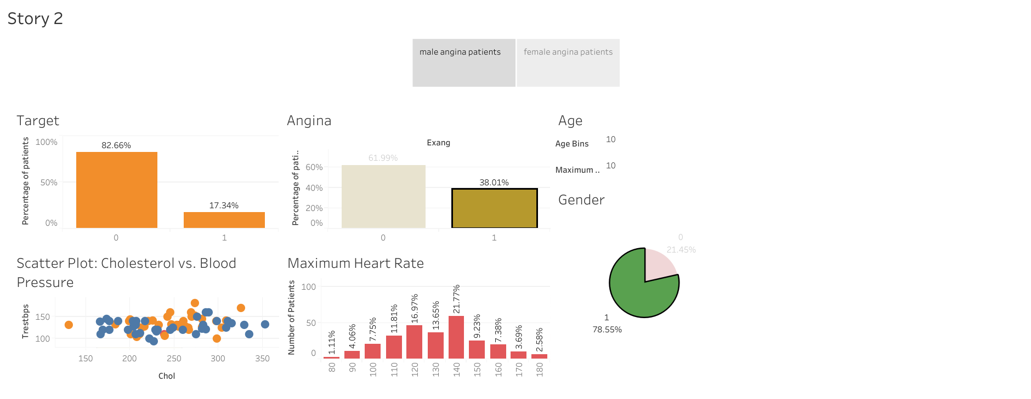

Slide 3
